Slide 1
Presentation of openlca2bw package LCA data transfer from OpenLCA to Brightway2
28/09/2022
FRANCOIS Cyrille
Research fellow
MAST-GPEM
Université Gustave-Eiffel

Slide 2
Openlca2bw package
LCA study rely a lot on data management and data processing
LCA software have become central
Today it exist a large panel of LCA software:
SimaPro, GaBi, OpenLCA, One click LCA, Sphera, ecochain, Umberto, Brightway2
Few are free and open-source
OpenLCA and Brightway2
2

Slide 3
Openlca2bw package
OpenLCA:
Free and open-source
Owned by GreenDelta
Software with user interface
Browsing database with ease
Many information fields
Large panel of analysis
Various allocations systems
Export of results (copy/paste)
Brightway2:
Collaborative and open-source
BSD-3-Clause license (permitive)
Large and open panel of analysis
Fast calculation
Open opportunities for research
Scenario construction
3

Slide 4
Openlca2bw package
OpenLCA:
Time of calculation and import
Memory issue
Preformated analysis
Preformated exports
Brightway2
Need Python knowledge
User interface
Allocation system
Low flexibility in modelling (units choice)
Formalism (name, code)
In public research and education free software are appreciated.
The choice between OpenLCA and Brightway2 depends on each researcher, its objectives, its available time and also its habits
4

Slide 5
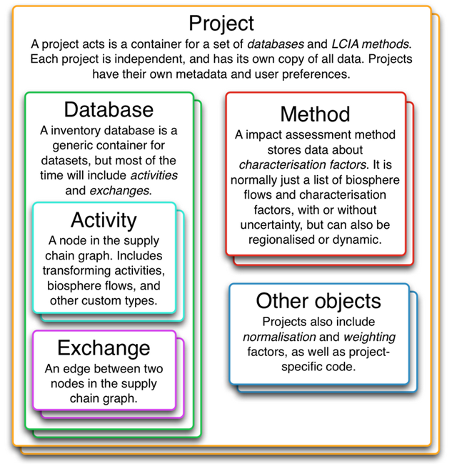
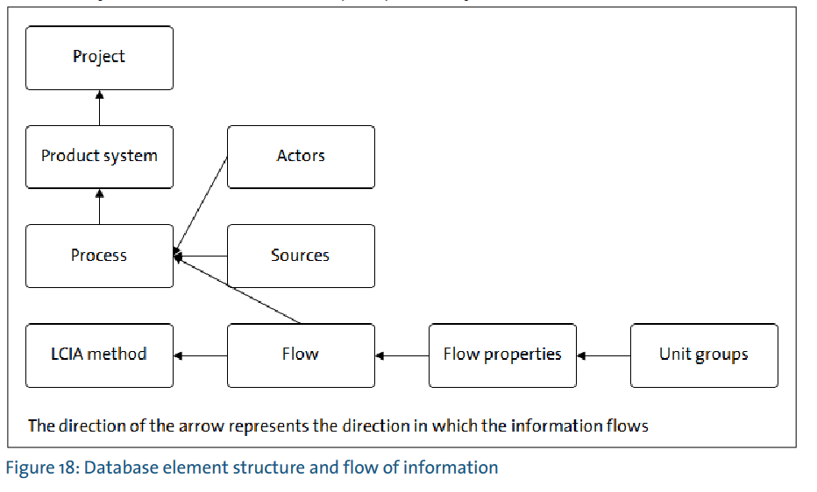
Openlca2bw package
Brightway2
Object-oriented programming
OpenLCA:
Database management and use (SQL)
JSON -> 1 file per object in each database
IPC connexion -> search and query DBs
5

Slide 6
Openlca2bw package
Brightway2
4321 elementary flows
Implemented LCIA methods
Press button and coding approachs
Activity-Browser
Fix unit per exchange
Data store in Python and easy to export
OpenLCA:
+90 000 elementary flows (emissions, resources and others (social or economic))
No LCIA methods per default but easy to import
Long to modify
Press button (or copy paste)
A bit long for some use
Large choice of units and properties
Export format: Ecospold1 XML, JSON-LD, zolca
Presence of developers tools
SQL or Python
6

Slide 7
Openlca2bw package
Issues to handle with
Construct a specific biosphere
Elementary flows conserve constant UID
Accommodate OpenLCA framework (folders) with Brightway2 framework (databases)
Which olca.folders in which bw.Database
Handling providers
Create a research routine but no idea how to deal with multi-provider (deleted)
Preserve all the information
DQ system, uncertainties (author, Model validation information are lost)
Parameters and formulas
Some exceptions for parameters, olca formula interpreter
Potential presence of both System and Unit processes in the same OpenLCA database
Brightway2 deals with Unit processes very well
Importing System processes is very long
7

Slide 8
Openlca2bw package
Next steps:
Allocation system for multioutputs activity
Actually, allocation factors are imported in BW2
Apply allocation system when importing -> duplicate processes
Check if package is compatible with brightway2.5
I believe it’s but not tested yet
How to reverse it -> bw2openlca ?
With IPC server -> client.insert()
Generate JSON-LD file from BW2
8

Slide 9
Thank you !!
Cyrille FRANCOIS
cyrille.francois@univ-eiffel.fr
https://github.com/cyrillefrancois

